Slide 1
I211 – Information Infrastructure II
Lecture 1

Slide 2
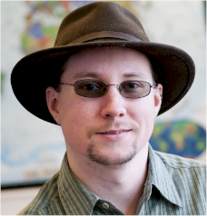
Instructor
John Duncan (I go by J)
PhD, Indiana University
Areas: Education, Security, Privacy, Social Informatics, Pervasive Computing, AI, Cognitive Science
Email: johfdunc@indiana.edu
Office location: Undergraduate Annex 201
Office hours: By Appointment
All slides are posted to Oncourse!

Slide 3
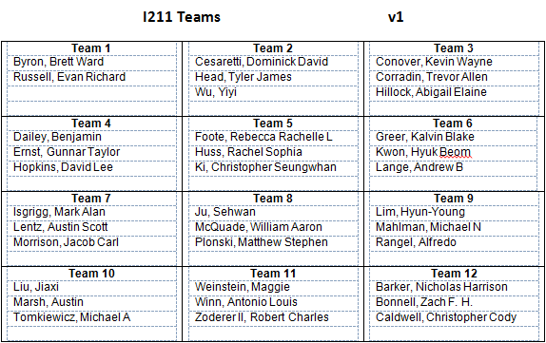
About You -> Teams!
How much previous programming experience do you have?
How long ago did you take I210 (or equivalent)?
How well do you feel you have mastered Python 2.x?

Slide 4





AI / UIs
 | Assistant | Email | Grading Groups
 | Ajinkya Awchat (AI) | ajawchat@indiana.edu | 1-3
 | Anthony (Tony) Granitto (UI) | agranitt@indiana.edu | 4-5
 | Jacob Gunden (UI) | jlgunden@indiana.edu | 6-7
 | James Martino (UI) | martino3@indiana.edu | 8-10
 | Do Un (John) Song (UI) | dounsong@indiana.edu | 11-12

Slide 5
Course Materials
No Course Textbook!
(But you might want a 2.X reference)
Slides, Syllabus, etc. on Oncourse.
Latest 2.7 release of Python:
https://www.python.org/download/releases/2.7.7/

Slide 6
Grading
35% Group Homeworks (lowest grade dropped)
20% Individual Homeworks (lowest grade dropped)
15% Lecture Exercises (in groups during lecture)
15% Midterm (open materials, during lecture)
15% Final Exam (open materials, during lecture)
Items marked in red will be done in groups.
All other work is individual.

Slide 7
Important Policies
Grade Questions
You have 1 week from when work is returned to raise any questions with your grader.
Late Work
Late work will receive a 20% penalty and will not be accepted more than 24 hours after the due date. In any group assignment, failure to turn in group feedback on time will result in a 50% penalty.
Academic Dishonesty
The standard penalty for any form of academic dishonesty in a course is failure of the course. All academic misconduct will be dealt with in strict accordance to the Code of Student Rights. Do not submit anything copied from the web! If you use any website as a reference, CITE IT!

Slide 8
Lecture Work
Sit next to your teammates. Get your number!
Group coding exercises – show us 1 solution.
Late? Penalties to your score. Absent? No points.
Excused absences – You earn what your team earns.
Computer & device policy

Slide 9
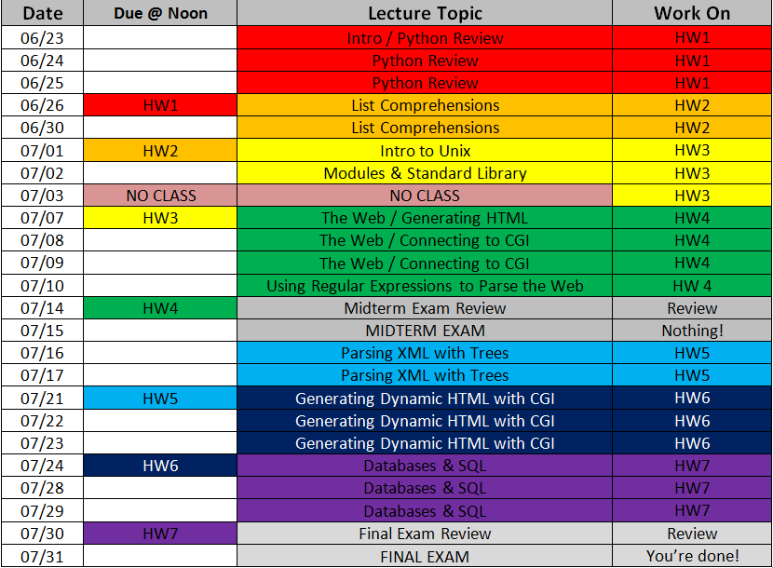
Schedule
Topics / Schedule
These dates are subject to change depending on our progress, but any changes will be announced over OnCourse!
Assignments are due at NOON on the day indicated.

Slide 10
Assignment 1
Due Thursday!
Up on Oncourse.
2 parts – Group and Individual

Slide 11
Variables in Python
Names are case-sensitive and unique, using letters, numbers, underscores (but start with a letter)
Two styles: my_num_var or myNumVar
acct_balance = 600 # = is the assignment operator
#raw_input gets user input. int() converts to an integer
deposit = int(raw_input("How much is the deposit? "))
#print auto-converts to string when possible
print "The new balance is: $", acct_balance + deposit

Slide 12
Reserved Words
Don’t use reserved words (keywords):
import keyword
print "Python keywords: ", keyword.kwlist
Python keywords: ['and', 'as', 'assert', 'break', 'class', 'continue', 'def', 'del', 'elif', 'else', 'except', 'exec', 'finally', 'for', 'from', 'global', 'if', 'import', 'in', 'is', 'lambda', 'not', 'or', 'pass', 'print', 'raise', 'return', 'try', 'while', 'with', 'yield']

Slide 13
Escape Sequences
To print special characters, we use the backslash ( \ ):
print "Escape Sequences:"
print "To print a quote inside quotes: \" "
print "To print a backslash: \\ "
print "Tabs:\t\tColumn1\t\tColumn2\t\tColumn3\t\tColumn4"
print "Newlines:\nRow1\n\nRow2\n\nRow3\n"

Slide 14
Basic Data Types
#basic data types
name = "Alan Reed" #name is a string
age = 27 #age is an int(eger)
gpa = 3.51 #gpa is a float
enrolled = True #enrolled is a boolean
print "Student:", name, "\tAge:", age, "\tGPA:", gpa, "\tEnrolled?", enrolled
>>>
Student: Alan Reed Age: 27 GPA: 3.51 Enrolled? True

Slide 15
Data Type Conversion
We can tell Python to convert from one data type to another:
int("3") → 3
str(3.0) → "3.0"
float(3) → 3.0

Slide 16
String Methods
Strings have a number of useful built-in methods (these do not change the original string!) :
text = "\n\tLet's code some Python!\n"
print "Original:", text
print "Uppercase:", text.upper()
print "Lowercase:", text.lower()
print "No Whitespace:", text.strip()
print "Changed:", text.replace("code", "learn")

Slide 17
Mathematical Operators
#numeric operators
num1 = 100
num2 = 7
print "The sum of", num1, "and", num2, "is:", num1 + num2
print "The difference of", num1, "and", num2, "is:", num1 - num2
print "The product of", num1, "and", num2, "is:", num1 * num2
print num1, "to the power of", num2, "is:", num1 ** num2
print num1, "divided by", num2, "is:", num1 / num2 #int by int division rounds down!
print num1, "divided by", num2, " (accurately) is:", float(num1) / num2
print "The integer remainder of", num1, "divided by", num2, "is:", num1 % num2
>>>
The sum of 100 and 7 is: 107
The difference of 100 and 7 is: 93
The product of 100 and 7 is: 700
100 to the power of 7 is: 100000000000000
100 divided by 7 is: 14
100 divided by 7 (accurately) is: 14.2857142857
The integer remainder of 100 divided by 7 is: 2

Slide 18
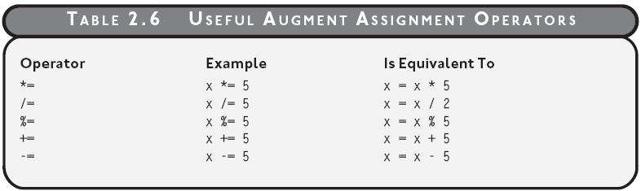
Augmented Assignment Operators
Original: score = score + 1
Augmented: score += 1

Slide 19
Cylinder Surface Area (Group Work)
Write a program that:
Asks the user to enter the height of the cylinder (in cm),
The radius of the circle at each end(in cm),
And that calculates the surface area of that cylinder.
Print out the area (in square centimeters)
Example code:
import math #allows you to use math.pi
variable = raw_input("Message")
print "output"
int(variable)

Slide 20
Cylinder Surface Area (Solution)
import math
#Get user input
height = int(raw_input("Please enter the height of the cylinder (in cm): "))
radius = int(raw_input("Please enter the radius of the circle (in cm): "))
#Calculate the area of the end caps of the tube
caps = 2 * math.pi * (radius * radius)
#Calculate the area of the body of the tube
body = height * 2 * math.pi * radius
#Print out the surface area
print "The surface area is", caps + body, "cm^2."

Slide 21
Comparison Operators
Operator | Name | Example | Truth Value
== | Equals | 5 == 6 | False
!= | Not Equal | 5 != 6 | True
> | Greater Than | 5 > 6 | False
>= | Greater Than or Equal | 5 >= 6 | False
< | Less Than | 5 < 6 | True
<= | Less Than or Equal | 5 <= 6 | True
It’s easy to confuse = and ==

Slide 22
If statements, Elif, Else
grade = int(raw_input("Please enter your grade (out of 100): "))
if grade >= 97: #Boolean condition!
print "That's an A+."
elif grade >= 93 : #We know grade < 97
print "That's an A."
elif grade >= 90 : #We know grade < 93
print "That's an A-."
else : #If we get here, grade < 90
print "You didn't get any sort of A."
print "Make sure you read all assignments carefully!"

Slide 23
And, Or, Not
num = int(raw_input("Please enter your favorite number: "))
if ( num >= -10 ) and ( num <= 10 ): #true when both are true
print "Your favorite number is a single digit."
if not (num < 0): # reverses the truth value
print "Your favorite number is 0 or a positive number."
if (num % 2 == 0) or (num % 3 == 0): #true when either is true
print "Your favorite number is divisible by 2 or 3."
>>>
Please enter your favorite number: 9
Your favorite number is a single digit.
Your favorite number is 0 or a positive number.
Your favorite number is divisible by 2 or 3.

Slide 24
Basic Loops
num = int(raw_input("Please enter an odd number: "))
#while loops run as long as some Boolean condition is True
while num % 2 != 1:
print "That's not odd!"
num = int(raw_input("Please enter an odd number: "))
#for loops run over a sequence, such as a list of numbers
print "The integers from 1 to", num, "are:", #suppressed new line!
for i in range(1,num+1):
print i,
>>>
Please enter an odd number: 4
That's not odd!
Please enter an odd number: 5
The integers from 1 to 5 are: 1 2 3 4 5

Slide 25
Nested for loop
for i in range(3):
for j in range(4):
print "*",
print
>>>
* * * *
* * * *
* * * *
i and j are traditionally used as counters for nested loops, followed by k, etc.
i = row, j = column
print by itself simply produces a newline!

Slide 26
Hmm…
students = int(raw_input("I need to assign student groups of 3. How many students? "))
num = 1
while students :
print "The next three students are in Group:", num
students -= 3
num += 1
print "All students assigned!"
#The output for 9 and 10 here is very different!

Slide 27
Tracing & Stopping the Shell
If something’s going wrong, we may want to perform a trace on a variable.
This just means using print to output its value at some helpful point in the program.
Traces are best just before and just after a variable’s value is modified!
If we get an Infinite Loop, just restart the Shell!

Slide 28
Break and Intentional Infinite Loops
while True: #intentional infinite loop!
value = int(raw_input("Enter a number between 1 and 10: "))
if (value >= 1) and (value <= 10):
break #we immediately leave the loop
print value
>>>
Enter a number between 1 and 10: 100
Enter a number between 1 and 10: -2
Enter a number between 1 and 10: 5
5

Slide 29
Numbers (Group Work)
Write a program to take numbers from the user until they enter some special input, like “STOP”. Then ask the user to enter either + or *. If they enter +, add all the numbers up. If they enter *, multiply them all together.
Useful code:
while Boolean Condition :
in = raw_input(“message”)
+= or *= operator

Slide 30
Numbers (Solution)
num_sum = 0
product = 1
num = raw_input("Please enter a number or STOP: ")
while num != "STOP":
num_sum += int(num) #have to do the conversion here
product *= int(num)
num = raw_input("Please enter a number or STOP: ")
operation = raw_input("Please enter an operation ('+' or '*'): ")
if operation == "+":
print "The total sum is", num_sum
else:
print "The total product is", product

Slide 31
Indexing
0 | 1 | 2 | 3 | 4 | 5 | 6 | 7 | 8 | 9 | 10 | 11 | 12 | 13
I |  | l | i | k | e |  | P | y | t | h | o | n | .
-14 | -13 | -12 | -11 | -10 | -9 | -8 | -7 | -6 | -5 | -4 | -3 | -2 | -1
Strings (and all other sequences) have index numbers (positive and negative)
string = "I like Python."
print string[7], string[3], string[-9]
>>>
P i e

Slide 32
Random numbers, slicing, len
import random #allows us to use the random module
quote = raw_input("Please enter a quote you like: ")
start = random.randrange(len(quote)) #len(string) is the length of the string
end = random.randrange(len(quote)) #in characters
if end < start:
start, end = end, start
print "A random slice of your quote:", quote[start: end] #slicing uses index numbers
>>>
Please enter a quote you like: This is Sparta!
A random slice of your quote: is Spar
>>>
Please enter a quote you like: Now is the winter of our discontent.
A random slice of your quote: en

Slide 33
in – String Operator
text = raw_input("Please enter some text: ")
if "e" in text :
print "The letter e is in: ", text
in allows us to test for a certain element (can be any length) being part of a sequence.

Slide 34
Letter Count
text = raw_input("Enter word: ")
letter = raw_input("Enter letter: ")
count = 0
for ch in text:
if ch.lower() == letter.lower():
count += 1
print letter, "was found", count, "times."

Slide 35
Constants
VOWELS = "aeiou"
EXCHANGE_RATE = 23.4
A variable whose value isn’t going to change is called a constant.
By convention in Python, names for those variables are put in all caps.

Slide 36
Tuples
Tuples are a data type for a sequence of data items. You can use pretty much any type of data.
(Tuples are also known as arrays.)
Creating tuples is easy:
number_tuple = (10, 2, -4, 60)
string_tuple = (“a”, “ee”, “iii”, “oooo”, “uuuuu”)
mixed_tuple = (“test”, 5, 8.9, “wow”)
empty_tuple = ()

Slide 37
Using Tuples
animals = ("cat", "dog", "bird", "snake", "elephant")
print "There are", len(animals), "types of animal:"
for type in animals:
print "\t", type,
print
if "bear" in animals:
print "We know about bears."
else:
print "Bears are mysterious."
print "The last animal is:", animals[-1]
>>>
There are 5 types of animal:
cat dog bird snake elephant
Bears are mysterious.
The last animal is: elephant

Slide 38
Immutable vs Mutable Sequences
Mutable: Changeable
Immutable: Unchangeable
String immutability -- Strings are immutable sequences; can’t be altered
Tuples are immutable too!

Slide 39
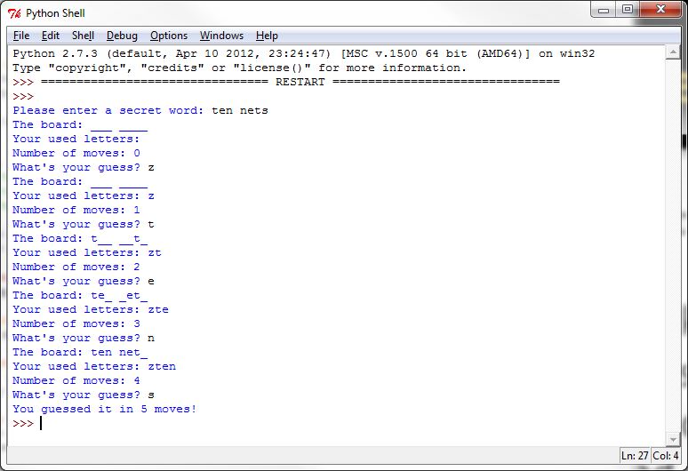
Letter Guess (Group Work)
Code this letter-guessing game!
It keeps track of:
letters used,
number of moves
currently solved letters

Slide 40
Letter Guess (Solution)
secret = raw_input("Please enter a secret word: ")
#set up the game
display = ""
used = ""
moves = 0
for letter in secret:
if letter != " ":
display += "_"
else:
display += " "
#main loop
while True:
print "The board:", display
print "Your used letters:", used
print "Number of moves:", moves
guess = raw_input("What's your guess? ")
guess = guess.lower()
#we have to build a new string (immutable)
new_display = ""
for i in range(len(secret)):
if secret[i] == guess:
new_display += guess
else:
new_display += display[i]
display = new_display
#update the values
used += guess
moves += 1
#check for a win
if secret == display:
print "You guessed it in", moves, "moves!"
break

Slide 41
Questions?

